Slide 1
Factor Analysis
Psy 524
Dr. Andrew Ainsworth
Psychology Department
California State university, Northridge

Slide 2
Factor Analysis?
Data Reduction/Pattern Identification
Measurement Theory/Psychometrics
Scale Creation
“Smart” Composite Creation
Test Theory/Development
Scale/Item Reliability

Slide 3
Correlation Matrix – Math Anxiety Scale (MAS)

Slide 4
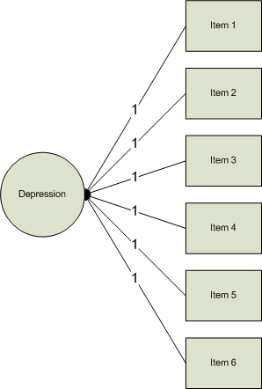
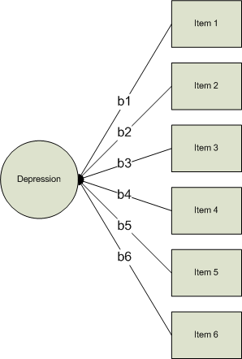

Slide 5
What is Factor Analysis (FA)?
FA and PCA (principal components analysis) are methods of data reduction
Take many variables and explain them with a few “factors” or “components”
Correlated variables are grouped together and separated from other variables with low or no correlation

Slide 6
What is FA?
Patterns of correlations are identified and either used as descriptive (PCA) or as indicative of underlying theory (FA)
Process of providing an operational definition for latent construct (through a regression like equation)

Slide 7
What is FA?
FA and PCA are not much different than canonical correlation in terms of generating canonical variates from linear combinations of variables
Although there are now no “sides” of the equation
And your not necessarily correlating the “factors”, “components”, “variates”, etc.

Slide 8
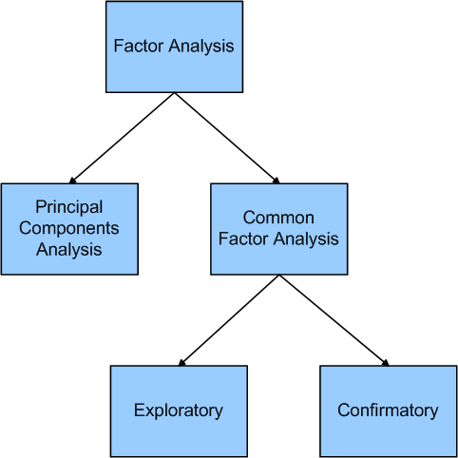

Slide 9
General Steps to FA
Step 1: Selecting and Measuring a set of items in a given domain
Step 2: Data screening in order to prepare the correlation matrix
Step 3: Factor Extraction
Step 4: Factor Rotation to increase interpretability
Step 5: Interpretation
Step 6: Further Validation and Reliability of the measures

Slide 10
Factor Analysis Questions
Three general goals: data reduction, describe relationships and test theories about relationships
How many interpretable factors exist in the data? or How many factors are needed to summarize the pattern of correlations?
What does each factor mean? Interpretation?
What is the percentage of variance in the data accounted for by the factors?

Slide 11
Factor Analysis Questions
Which factors account for the most variance?
How well does the factor structure fit a given theory?
What would each subject’s score be if they could be measured directly on the factors?

Slide 12
Types of FA
Exploratory FA
Summarizing data by grouping correlated variables
Investigating sets of measured variables related to theoretical constructs
Usually done near the onset of research
The type we are talking about in this lecture

Slide 13
Types of FA
Confirmatory FA
More advanced technique
When factor structure is known or at least theorized
Testing generalization of factor structure to new data, etc.
This is often tested through Structural Equation Model methods (i.e., Psy534 topic)

Slide 14
Common Factor Model
As opposed to the not-so-common factor model

Slide 15
Quick Detour: Classical Test Theory (CTT)
Assumes that every person has a true score on an item or a scale if we can only measure it directly without error
CTT analyses assumes that a person’s test score is comprised of their “true” score plus some measurement error.
This is the common true score model

Slide 16
Common Factor Model
The common factor model is like the true score model where:
Except let’s think of it at the level of variance for a second

Slide 17
Common Factor Model
Since we don’t know T let’s replace that with what is called the “common variance” or the variance that this item shares with other items in the test
This is called communality and is indicated by h-squared

Slide 18
Common Factor Model
The variance in each item making up a factor is separated into variance that is shared among all the items or “common variance” which is called h-squared
And unique variance (u-squared) which is made up of variance that is specific to this item and random error (but we can’t pull them apart)

Slide 19
Common Factor Model

Slide 20
Common Factor Model
The common factor model assumes that the commonalities represent variance that is due to the concept (i.e. factor) you are trying to measure
That’s great but how do we calculate communalities?

Slide 21
Common Factor Model
Let’s think about this as a regression approach
The multiple regression equation from before:
Or it’s more general form:
Now, let’s think about this more theoretically

Slide 22
Common Factor Model
Still rethinking regression
So, theoretically items don’t make up a factor (e.g. depression), the factor should predict scores on the item
Example: if you know someone is “depressed” then you should be able to predict how they will respond to each item on the CES-D

Slide 23
Common Factor Model
Regression Model Flipped Around
Let’s predict the item from the Factor(s)
Where is the item on a scale
is the relationship (loading) b/t factor and item
is the Factor
is the uniqueness predicting the item from the factor

Slide 24
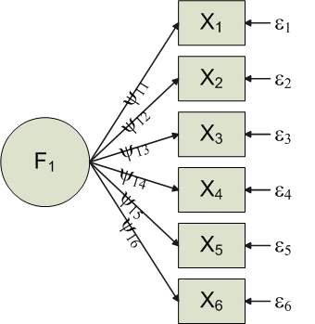
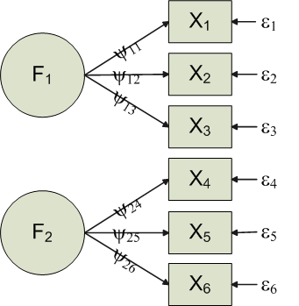
Notice the change in the direction of the arrows to indicate the flow of theoretical influence.

Slide 25
Common Factor Model
Communality
The communality is a measure of how much each item is explained by the Factor(s) and is therefore also a measure of how much each item is related to other items.
The communality for each item is calculated by
Whatever is left in an item is the uniqueness

Slide 26
Common Factor Model
The big burning question
How do we predict items with factors we can’t measure directly?
This is where the mathematics comes in
Long story short, we use the same eigenvalue decomposition we used in canonical correlation to create vectors we use as proxies for the latent factors

Slide 27
FA Terms and Matrices
I’ve always wanted to learn a new language

Slide 28
Factor Analysis Terms
Observed Correlation Matrix – is the matrix of correlations between all of your items
Reproduced Correlation Matrix – the correlation that is “reproduced” by the factor model
Residual Correlation Matrix – the difference between the Observed and Reproduced correlation matrices

Slide 29
Factor Analysis Terms
Extraction – refers to 2 steps in the process
Method of extraction (there are dozens)
PCA is one method
FA refers to a whole mess of them
Number of factors to “extract”
Loading – is a measure of relationship (analogous to correlation) between each item and the factor(s); the Ψ’s in the common factor model

Slide 30
Matrices

Slide 31
Matrices

Slide 32
Factor Analysis Terms
Factor Scores – the factor model is used to generate a combination of the items to generate a single score for the factor
Factor Coefficient matrix – coefficients used to calculate factor scores (like regression coefficients)

Slide 33
Factor Analysis Terms
Rotation – used to mathematically convert the factors so they are easier to interpret
Orthogonal – keeps factors independent
There is only one matrix and it is rotated
Interpret the rotated loading matrix

Slide 34
Factor Analysis Terms
Rotation – used to mathematically convert the factors so they are easier to interpret
Oblique – allows factors to correlate
Factor Correlation Matrix – correlation between the factors
Structure Matrix – correlation between factors and variables
Pattern Matrix – unique relationship between each factor and an item uncontaminated by overlap between the factors (i.e. the relationship between an item an a factor that is not shared by other factors); this is the matrix you interpret

Slide 35
Factor Analysis Terms
Simple Structure – refers to the ease of interpretability of the factors (what they mean).
Achieved when an item only loads highly on a single factor when multiple factors exist (previous slide)
Lack of complex loadings (items load highly on multiple factors simultaneously
NOTE: Typically a “good” factor makes sense, has simple structure and is interpretable.

Slide 36
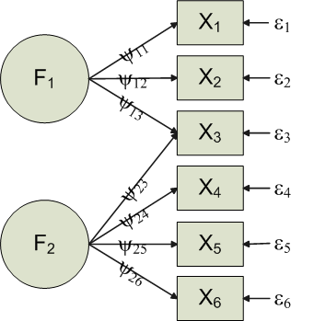
Simple vs. Complex Loading

Slide 37
Problems w/ FA
No simple statistical test
Mix of “art” and “science”
Extraction and rotation methods
# Factors to extract
Communality estimates
Last resort/Life (research) saver

Slide 38
Assumptions
When you assume…

Slide 39
Assumptions – reliable correlations
Assumes reliable correlations
Highly affected by missing data, outlying cases, non-normal and truncated data
Data screening methods (e.g. transformations, etc.) can greatly improve poor factor analytic results

Slide 40
Assumptions – Sample Size
Sample Size and Missing Data
True missing data (MCAR) are handled in the usual ways (Data Screening Chapter) but regression methods may overfit
Factor analysis needs large samples and it is one of the only major limitations
Correlation Reliability ⬆ ; # Subjects ⬇
Need “enough” subjects for stable estimates
Also, items ⬆ ; subjects ⬆

Slide 41
Assumptions – Sample Size
Comrey and Lee
50 very poor, 100 poor, 200 fair, 300 good, 500 very good and 1000+ excellent
Shoot for minimum of 300 usually
More highly correlated the “marker variables”, less subjects

Slide 42
Assumptions - Distribution
Normality
Univariate – good but not necessary
Multivariate – is assumed when assessing number of factors; however, usually tested univariately

Slide 43
Assumptions - Relationships
Multicollinearity/Singularity
In PCA it is not problem; no inversions
In FA, if det(R) or any eigenvalue approaches 0 → multicollinearity is likely
Also investigate inter-item SMCs approaching 1

Slide 44
Assumptions – “Factorable”
Factorable R matrix
Inter-item correlations > .30 or FA is unlikely
Large inter-item correlations necessary but not sufficient
Duos
Multidimensionality
Matrix of partials adjusted for other variables
Other tests with other assumptions
(e.g., tetrachoric or polychoric correlations)

Slide 45
Assumptions – “Good” Variables
Variables as outliers
Some variables don’t work
Explain very little variance
Relates poorly with factor
Low SMCs with other items
Low loadings

Slide 46
Extraction and Rotation
So many choices…

Slide 47
Extraction Methods
There are many (dozens at least)
All extract orthoganal sets of factors (components) that reproduce the R matrix
Different techniques – some maximize variance, others minimize the residual matrix (R – reproduced R)
With large stable sample they all should be relatively the same

Slide 48
Extraction Methods
Usually un-interpretable without rotation (next)
Differ in output depending on combinations of:
Extraction method
Communality estimates
Number of factors extracted
Rotational Method

Slide 49
Extraction Methods: FA (family) vs. PCA
FA (family) produces factors; PCA produces components
Factors cause variables; components are aggregates of the variables

Slide 50
Conceptual FA vs. PCA

Slide 51
Extraction Methods: FA (family) vs. PCA
FA analyzes only the variance shared among the variables (common variance without unique variance)
PCA analyzes all of the variance
FA: “What are the underlying processes that could produce these correlations?”
PCA: Just summarize empirical associations, very data driven

Slide 52
Extraction Methods: FA (family) vs. PCA
PCA vs. FA (family)
PCA begins with 1s in the diagonal of the correlation matrix
All variance extracted
Each variable giving equal weight initially
Commonalities are estimated as the output of the model and are typically inflated
Can often lead to an over extraction of factors as well

Slide 53
Extraction Methods: FA (family) vs. PCA
PCA vs. FA (family)
FA begins by trying to only use the common variance
This is done by estimating the communality values (e.g. SMC) and placing them in the diagonal of the correlations matrix
Analyzes only common variance
Outputs a more realistic (often smaller) communality estimate
Usually results in far fewer factors overall

Slide 54
Extraction Methods: FA
Principal (Axis) Factors
Estimates of communalities (SMC) are in the diagonal; used as starting values for the communality estimation (iterative)
Removes unique and error variance
Solution depends on quality of the initial communality estimates

Slide 55
Extraction Methods: FA
Maximum Likelihood
Computationally intensive method for estimating loadings that maximize the likelihood (probability) of the correlation matrix.
Unweighted least squares – ignores diagonal and tries to minimize off diagonal residuals
Communalites are derived from the solution
Originally called Minimum Residual method (Comrey)

Slide 56
Extraction Methods: FA
Generalized (weighted) least squares
Also minimizes the off diagonal residuals
Variables with larger communalities are given more weight in the analysis
Many Other methods

Slide 57
Rotation Methods
After extraction (regardless of method) good luck interpreting result
Rotation is used to improve interpretability and utility
A orthogonally rotated solution is mathematically equivalent to un-rotated and other orthogonal solutions
Stable and large N -> same result

Slide 58
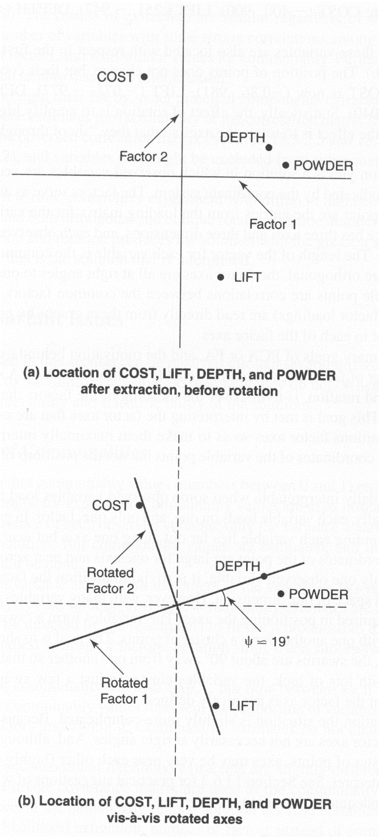
Geometric Rotation

Slide 59
Geometric Rotation
Factor extraction equivalent to coordinate planes
Factors are the axes
Length of the line from the origin to the variable coordinates is equal to the communality for that variable
Orthogonal Factors are at right angles

Slide 60
Geometric Rotation
Factor loadings are found by dropping a line from the variable coordinates to the factor at a right angle
Repositioning the axes changes the loadings on the factor but keeps the relative positioning of the points the same

Slide 61
Rotation Methods
Orthogonal vs. Oblique
Orthogonal rotation keeps factors un-correlated while increasing the meaning of the factors
Oblique rotation allows the factors to correlate leading to a conceptually clearer picture but a nightmare for explanation

Slide 62
Rotation Methods: Orthogonal
Varimax – most popular
Simple structure by maximizing variance of loadings within factors across variables
Makes large loading larger and small loadings smaller
Spreads the variance from first (largest) factor to other smaller factors

Slide 63
Rotation Methods: Orthogonal
Quartimax
Opposite of Varimax
Simplifies variables by maximizing variance with variables across factors
Varimax works on the columns of the loading matrix; Quartimax works on the rows
Not used as often; simplifying variables is not usually a goal

Slide 64
Rotation Methods: Orthogonal
Equamax is a hybrid of the earlier two that tries to simultaneously simplify factors and variables
Not that popular either

Slide 65
Rotation Methods: Oblique
Direct Oblimin
Begins with an unrotated solution
Has a parameter (gamma in SPSS) that allows the user to define the amount of correlation acceptable; gamma values near -4 -> orthogonal, 0 leads to mild correlations (also direct quartimin) and 1 highly correlated

Slide 66
Rotation Methods: Oblique
Oblique Rotation Techniques
Promax
Solution is rotated maximally with an orthogonal rotation
This is followed by oblique rotation
Orthogonal loadings are raised to powers in order to drive down small loadings
Simple structure is reached
Easy and quick method

Slide 67
Equations
A super skimpy look into the equations with an example

Slide 68
Equations – Extraction Principal Components Analysis

Slide 69
Equations – Extraction
Correlation matrix w/ 1s in the diag
Large correlation between Cost and Lift and another between Depth and Powder
Looks like two possible factors

Slide 70
Equations – Extraction
Reconfigure the variance of the correlation matrix into eigenvalues and eigenvectors

Slide 71
Equations – Extraction
L=V’RV
Where L is the eigenvalue matrix and V is the eigenvector matrix.
This diagonalized the R matrix and reorganized the variance into eigenvalues
A 4 x 4 matrix can be summarized by 4 numbers instead of 16.

Slide 72
Equations – Extraction
R=VLV’
This exactly reproduces the R matrix if all eigenvalues are used
SPSS matrix output ‘factor_extraction.sps’
Gets pretty close even when you use only the eigenvalues larger than 1.
More SPSS matrix output

Slide 73
Equations – Extraction
Since R=VLV’ →
Then →
And →
𝑅=𝐴𝐴′, where A is the loading matrix and A′ is the transpose of the loading matrix.
See SPSS output from matrix syntax.

Slide 74
Equations – Extraction
Here we see that factor 1 is mostly Depth and Powder (Snow Condition Factor)
Factor 2 is mostly Cost and Lift, which is a resort factor
Both factors have complex loadings

Slide 75
Equations – Orthogonal Rotation
Factor extraction is usually followed by rotation in order to maximize large correlation and minimize small correlations
Rotation usually increases simple structure and interpretability.
The most commonly used is the Varimax variance maximizing procedure which maximizes factor loading variance

Slide 76
Equations – Orthogonal Rotation
The unrotated loading matrix is multiplied by a transformation matrix which is based on angle of rotation

Slide 77
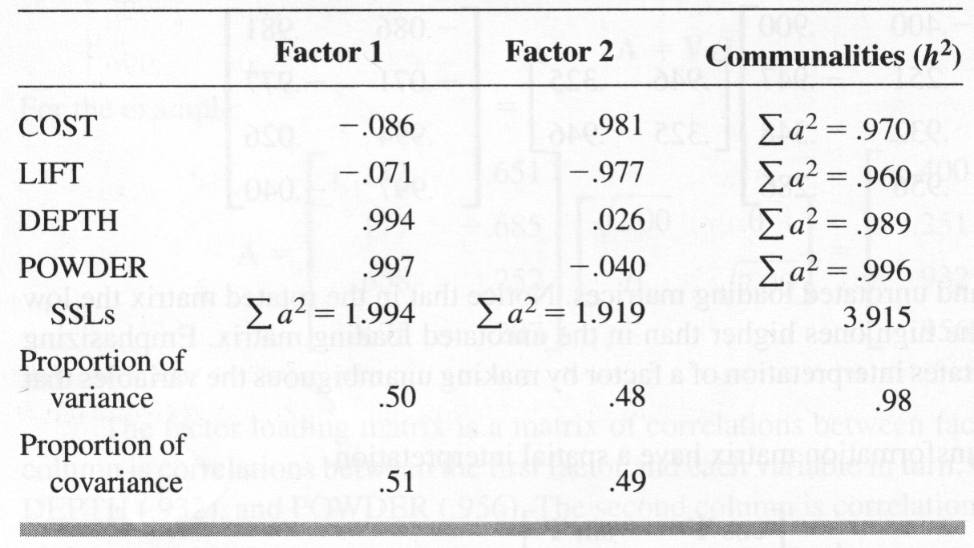
Equations – Other Stuff
Communalities are found from the factor solution by the sum of the squared loadings
97% of cost is accounted for by Factors 1 and 2

Slide 78
Equations – Other Stuff
Proportion of variance in a variable set accounted for by a factor is the SSLs for a factor divided by the number of variables
For factor 1 1.994/4 is .50

Slide 79
Equations – Other Stuff
The proportion of covariance in a variable set accounted for by a factor is the SSLs divided by the total communality (or total SSLs across factors)
1.994/3.915 = .51

Slide 80
Equations – Other Stuff
The residual correlation matrix is found by subtracting the reproduced correlation matrix from the original correlation matrix.
See matrix syntax output
For a “good” factor solution these should be pretty small.
The average should be below .05 or so.

Slide 81
Equations – Other Stuff
Factor weight matrix is found by dividing the loading matrix by the correlation matrix
See matrix output

Slide 82
Equations – Other Stuff
Factors scores are found by multiplying the standardized scores for each individual by the factor weight matrix and adding them up.

Slide 83
Equations – Other Stuff
You can also estimate what each subject would score on the (standardized) variables

Slide 84
Equations – Oblique Rotation
In oblique rotation the steps for extraction are taken
The variables are assessed for the unique relationship between each factor and the variables (removing relationships that are shared by multiple factors)
The matrix of unique relationships is called the pattern matrix.
The pattern matrix is treated like the loading matrix in orthogonal rotation.

Slide 85
Equations – Oblique Rotation
The Factor weight matrix and factor scores are found in the same way
The factor scores are used to find correlations between the variables.

Slide 86
Equations – Oblique Rotation

Slide 87
Equations – Oblique Rotation
Once you have the factor scores you can calculate the correlations between the factors (phi matrix; Φ)

Slide 88
Equations – Oblique Rotation

Slide 89
Equations – Oblique Rotation
The structure matrix is the (zero-order) correlations between the variables and the factors.

Slide 90
Equations – Oblique Rotation
With oblique rotation the reproduced factor matrix is found be multiplying the structure matrix by the pattern matrix.

Slide 91
What else?
How many factors do you extract?
One convention is to extract all factors with eigenvalues greater than 1 (e.g. PCA)
Another is to extract all factors with non-negative eigenvalues
Yet another is to look at the scree plot
Number based on theory
Try multiple numbers and see what gives best interpretation.

Slide 92
Eigenvalues greater than 1

Slide 93
Scree Plot

Slide 94
What else?
How do you know when the factor structure is good?
When it makes sense and has a simple (relatively) structure.
How do you interpret factors?
Good question, that is where the true art of this comes in.

